Slide 1
Christian Presence in Jerusalem
Present & Future

Slide 2
Who are the Christians of Jerusalem
Christian community in Jerusalem is a mixture combination of:
1- The indigenous Christians “Living Stones” & “Salt of the Earth”
2- Clergy and members of religious orders
3- Expatriate Christians living in the Holy Land

Slide 3
The First “Christian Community”
The first Christian community started after the Pentecost, when the Holy Spirit came down on the disciples, as described in the Acts of the Apostles. Acts 2: 2-4
In the beginning, these early Christians originated were pagans, Arabs, Jewish and they are from Juda, Crete, Asia, Parthians, Meds, Mesopotamia, Cappadocia, Egypt, Libya and others. Acts 2: 2-11
Since every nation and civilization that came, settled, and eventually departed the Holy Land, left behind some of their traditions and beliefs. These traditions and beliefs merged with those of the Holy Land Christian community.

Slide 4
The Church Denomination
The Holy Land’s Christian identity comes from its Church affiliations ( denominations), and local Christian community.
13 official denominations of Christianity in the Holy Land.
Three Patriarchs reside in Jerusalem; Greek Orthodox, Roman Catholic (Latin), and Armenian.
10 other Archbishops and Bishops, five Catholic: (Melkite, Maronite, Syrian, Armenian, and Chaldean); three Orthodox: (Coptic, Syrian, and Ethiopian) and two Protestant: (Anglican and Lutheran).

Slide 5
Christian Community Population in Jerusalem
The Christian community population in Jerusalem estimated around 9 thousand which represents less than one percent of the total population of the city of Jerusalem While, the total population of Christians in the Holy Land estimated around 150,000.
The population of Jerusalem estimated around 1 million, in which 62% are Jews, 38% are Palestinians and less than 1 percent of the total population are Palestinian Christians

Slide 6
Population of the Christian community in Jerusalem
1905 – 13,000 out of 60,000
1913 – 16,750 out 74,800
1922 – 14,669 out 62,000
1931- 19,335 out of 90,451
1948- 25,000 out of 165,000
1967- 12,646 out of 262,000
2021- 9,000 out of 950,000

Slide 7
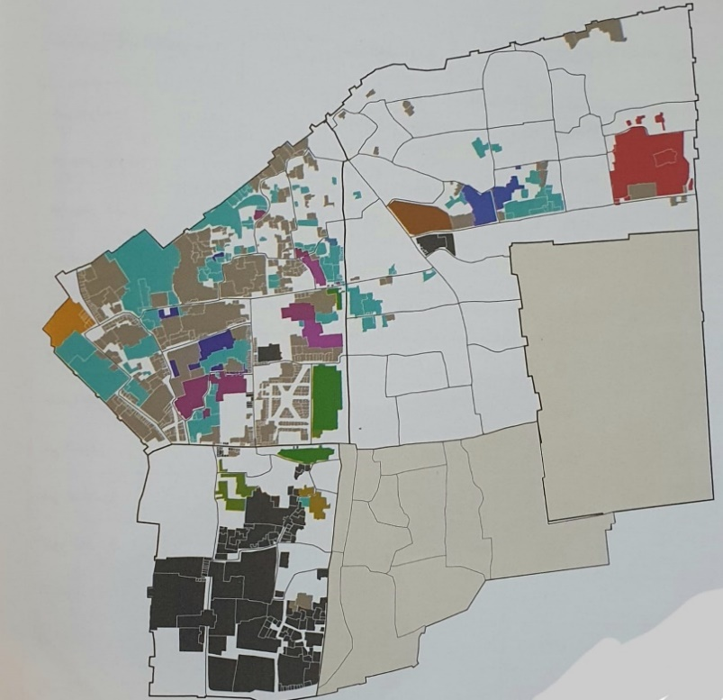
Church Entity in the Old City of Jerusalem
About one third of the Old City properties are owned, controlled and managed by the different Church Denominations
76 Churches, Shrines, Monasteries & Convents
More than 900 houses
About 500 commercial shops

Slide 8
Were do Christians live in the Old City of Jerusalem
Monastery residential compounds
14 monastery residential compounds
Christian residential compounds
8 residential compounds
Buildings, Private houses and Housh(s) (courtyards).

Slide 10
Church Entity outside the old city of Jerusalem
77 Churches, Shrines, Monasteries and convents
Around 350 houses (Apartments) outside the old city of Jerusalem located Beit Hanina, Al- Dahyeh, Bethphage, Beit Safafah
Around 65 % of the houses (apartments) are owned or built by different church denominations

Slide 11
Christian based Institutions in Jerusalem
25 Social & Development Institutions
15 Sport, Clubs & Cultural Centers
29 Christian Educational Institutions ( Kindergarten, Schools & Vocational Centers
15 Biblical, Theology, Philosophy and History educational Institutions
12 Christian related Libraries

Slide 12
Lack of knowledge to develop
The community Strength, Weakness, Opportunity and Threats
There is no such a thing (I think)
Lack of decisions based on facts

Slide 13
What Should be Done
"The best way to predict the future is to create it." According to a famous quote from Peter Drucker
Vision: What image of the future we seek to create to strengthen the Christian community in Jerusalem
Mission: Agreed statement of what we are suppose to be doing and why we are doing it
Strategic Plan: Strategic planning is a process that helps focus on aligning available collective resources to best take advantage of the opportunities

Slide 14
Developing Strategies to Strengthen the Christian Presence in Jerusalem
What actions might help the local Christian community in Jerusalem in order to preserve a strong Christian identity?

Slide 15
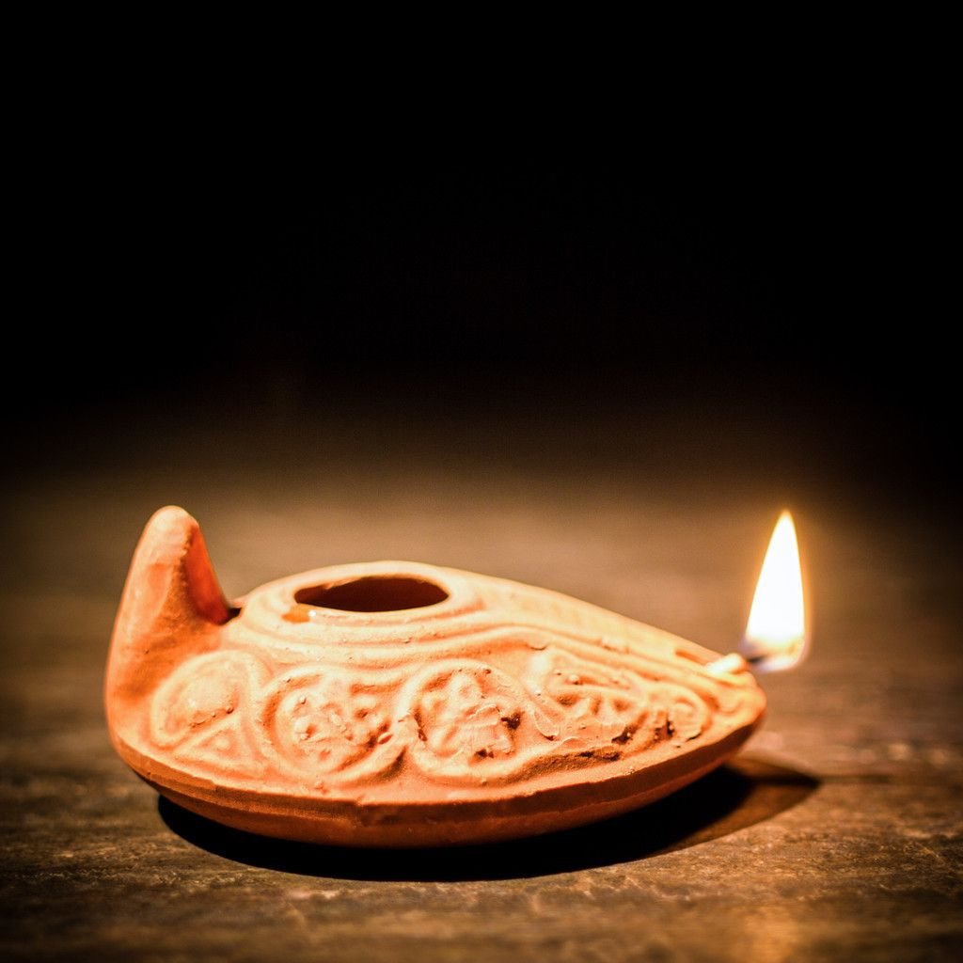
Candle VS Oil Lamp

Slide 16
Humanitarian Or Existence
The Christian community, related insinuations and The Church are the Pioneers to Provide human assistance to all the people
Lobbying "Existence, not poverty“
Building Public Awareness

